Slide 1

Challenging the Status Quo of Diversification:
An Analysis of Returns by Asset Class

Slide 2
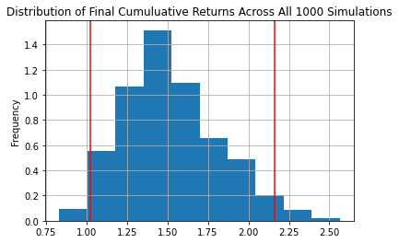
BONDS
• BLV • BND • EDV • VCLT • VGLT •
Monte Carlo Simulation 10 Years

Slide 3
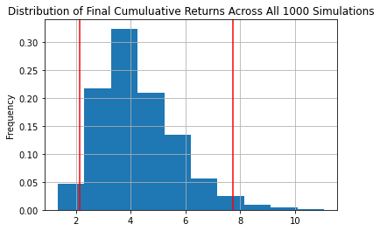
ETF
• EEM • VOO • VTI • VTV • VUG •
Monte Carlo Simulation 10 Years

Slide 4
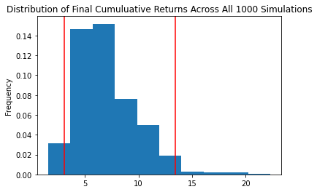
REAL ESTATE
• AMT • PLD • CCI • EQIX • PSA •
Monte Carlo Simulation 10 Years

Slide 5
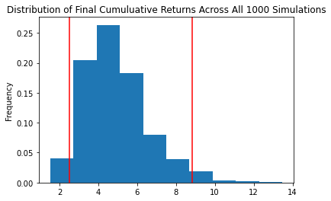
STOCKS
• FB • AMZN • AAPL • XOM • JPM •
• JNJ • HON • LIN • AMT • PG • NEE •
Monte Carlo Simulation 10 Years

Slide 6
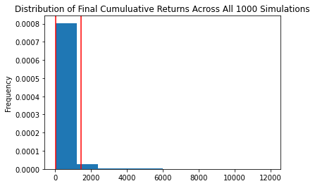
CRYPTO
• BTC • ETH • BNB • DASH • LTC •
Monte Carlo Simulation 10 Years

Slide 7
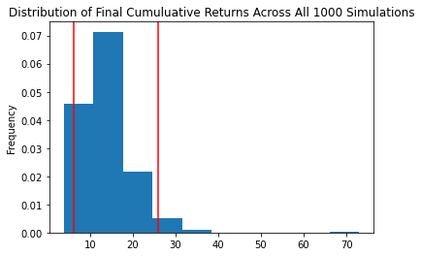
DIVERSIFIED
• VOO • MSFT • AAPL • BND • AMT •
• VUG • TSLA • AMZN • EDV • PLD •
Monte Carlo Simulation 10 Years

Slide 8
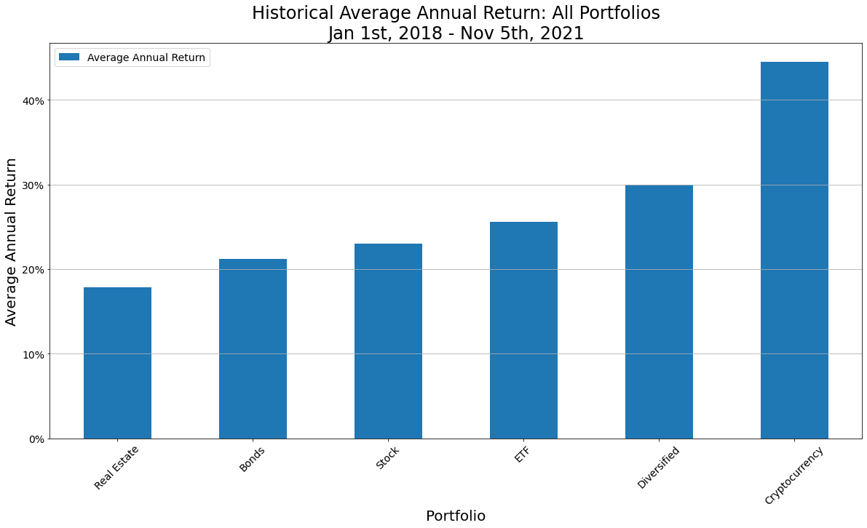
ANNUALIZED RETURNS
• Comparison Across Portfolios •

Slide 9
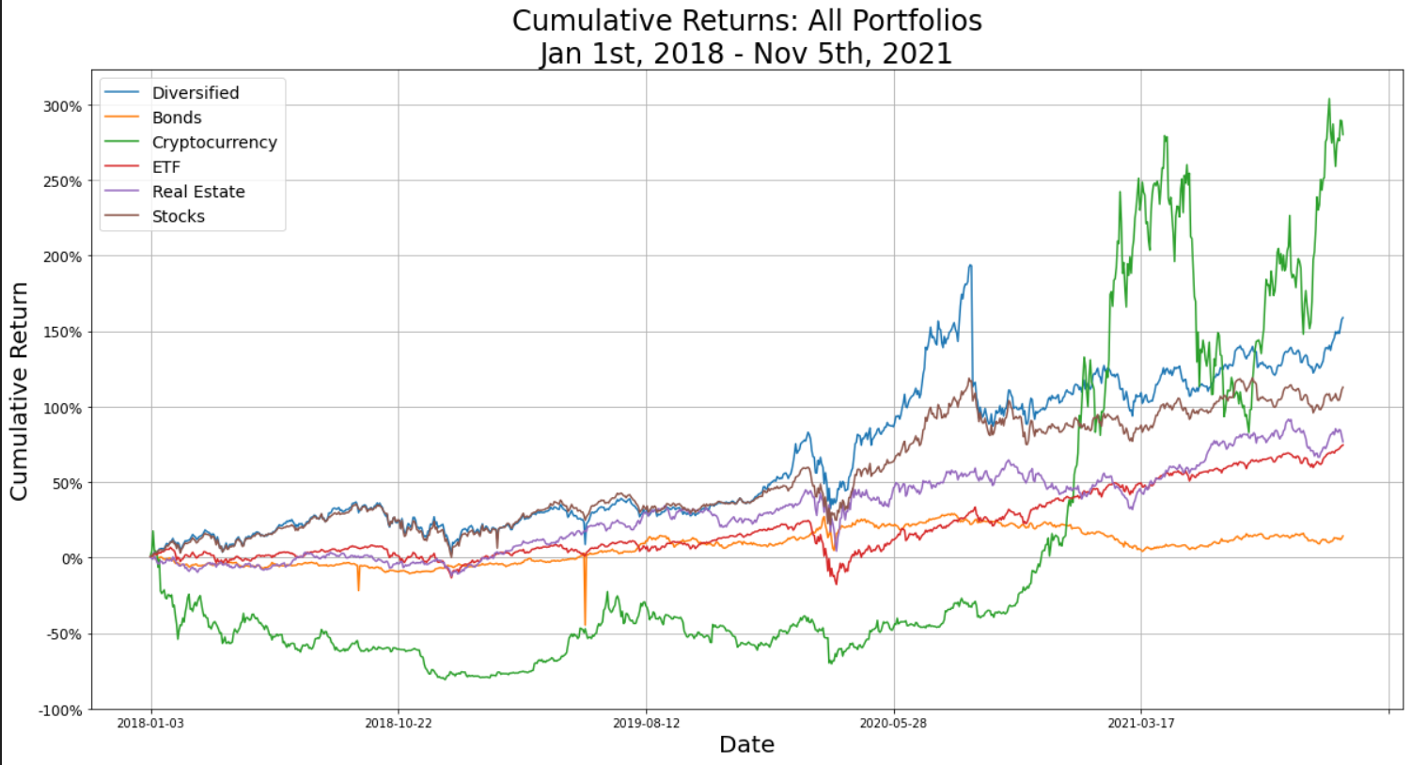
CUMULATIVE RETURNS
• Comparison Across Portfolios •

Slide 10
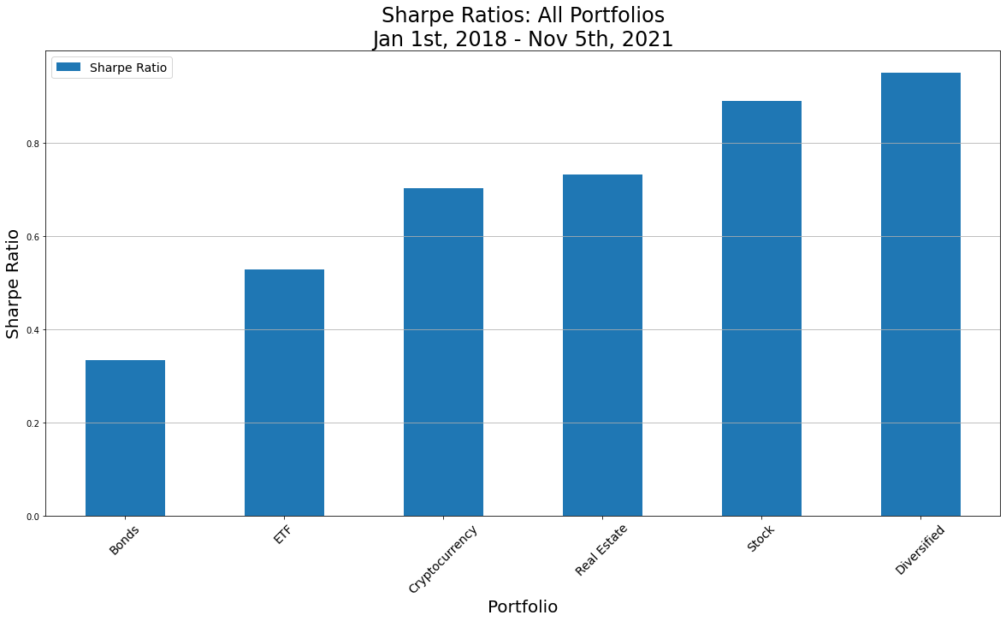
SHARPE RATIO
• Comparison Across Portfolios •
 | Bonds | ETF | Crypto | Real Est | Stock | Diversified
Annual Avg Return | 21.23% | 25.61% | 44.49% | 17.82% | 23.00% | 29.95%
Annual Std Dev | 63.58% | 48.54% | 63.38% | 24.33% | 25.87% | 31.53%

Slide 11
Two column bullet points
Bullets go in here
And also in here

Slide 12
Example of a table
Title | Title
Data | Data
Note: PowerPoint does not allow have nice default tables – but you can cut and paste this one

Slide 13
Sample Graph (3 colours)
 | Bonds | ETF | Crypto | Real Est | Stock | Diversified
Annual Avg Return | 21.23% | 25.61% | 44.49% | 17.82% | 23.00% | 29.95%
Annual Std Dev | 63.58% | 48.54% | 63.38% | 24.33% | 25.87% | 31.53%

Slide 14
Example of a chart (4 colours)

Slide 15

Picture slide
Bullet 1
Bullet 2

Slide 16
Examples of default styles
Text and lines are like this
Hyperlinks like this
Visited hyperlinks like this
Table
Text box
Text box
With shadow

Slide 17
Use of templates
You are free to use these templates for your personal and business presentations.
We have put a lot of work into developing all these templates and retain the copyright in them. They are not Open Source templates. You can use them freely providing that you do not redistribute or sell them.
Do
Use these templates for your presentations
Display your presentation on a web site provided that it is not for the purpose of downloading the template.
If you like these templates, we would always appreciate a link back to our website. Many thanks.
Don’t
Resell or distribute these templates
Put these templates on a website for download. This includes uploading them onto file sharing networks like Slideshare, Myspace, Facebook, bit torrent etc
Pass off any of our created content as your own work
You can find many more free templates on the Presentation Magazine website www.presentationmagazine.com

